Slide 1
Big Data
Pig Basics
LEVEL – PRACTITIONER

Slide 2
SR.Arun
Sr Devloper-Big Data / 9 Years
1.0

Slide 3









Icons Used
Hands on Exercise
Questions
Tools
Coding Standards
Test Your Understanding
Reference
A Welcome Break
Demonstration
Contacts

Slide 4
Overview
This chapter will introduce you to the Pig ( high-level platform for creating Map Reduce programs).
Pig Latin abstracts the programming from the Java Map Reduce idiom into a notation which makes Map Reduce programming high level, similar to that of SQL for RDBMS systems.

Slide 5
Objectives
After completing this chapter you will be able to :
Describe Pig Latin and Execution mode
Pig Data model
Pig Schema and Cast
Developing Pig Latin
Pig script example
Advance Pig Latin
Writing User Define Function

Slide 6
What is Pig
Apache Pig is a platform for analyzing large data sets that consists of a high-level language for expressing data analysis programs, coupled with infrastructure for evaluating these programs.
Pig is made up of two pieces:
• The language used to express data flows, called Pig Latin.
• The execution environment to run Pig Latin programs
Pig Latin is a data flow language, Allows users to describe how data from one or more inputs should be read, processed, and then stored to one or more outputs in parallel.

Slide 7
Why Pig
Opens the system to non-Java programmers.
Provides common operations like join, group, filter, and sort.
Much simpler than Java
10 lines of Pig Latin ≈ 200 lines of Java.
What took 4 hours to write in Java took 15 minutes in Pig Latin.
Early error checking
Chains multiple MR jobs

Slide 8
Execution mode
Local Mode
Launch single JVM
Access local file system
Pig Grunt - $ pig -x local
Hadoop Mode
Execute a sequence of MR jobs
Pig interacts with Hadoop master node
Pig Grunt - $ pig or pig –x map reduce

Slide 9
Pig Data model
Scalar types
Int, - 4 byte signed integer
long, - 8 byte signed integer
float, - 32 bit floating point
doube – 64 bit floating point
chararray - String, \t \n \u0001
bytearray – byte[]
Complex types
• A relation is a bag (more specifically, an outer bag).
• A bag is a collection of tuples.
• A tuple is an ordered set of fields.
• A field is a piece of data.

Slide 10
Pig Data model
Map
Map is set of key value pairs
Eg: ['name'#'bob', ‘age'#55]
Tuple
Ordered collection of Pig data elements.
Tuples are divided into fields.
Eg: ('bob', 55)
Bag
A bag is an unordered collection of tuples.
{('bob', 55), ('sally', 52), ('john', 25)}
Null
a null data element means the value is unknown.
data is missing or an error occurred in processing it.

Slide 11
Statement
A statement represents an operation, or a stage in the data flow.
Usually a variable is used to represent the result of the statement.
Not limited to data processing operations, but also contains file system operations.

Slide 12
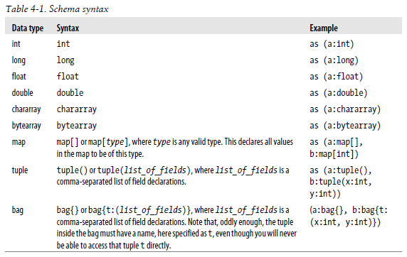
Schema
dividends = load 'NYSE_dividends' as (exchange:chararray, symbol:chararray, date:chararray, dividend:float);

Slide 13
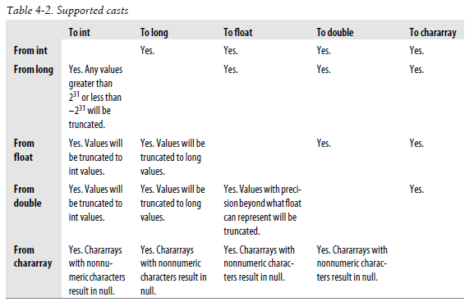
CAST
daily = load 'NYSE_daily' as (exchange:chararray, symbol:chararray, date:chararray, open: float, high: float, low: float, close:float,volume:int, adj_close:float);
rough = foreach daily generate volume * close;(implicit cast on rough)

Slide 14
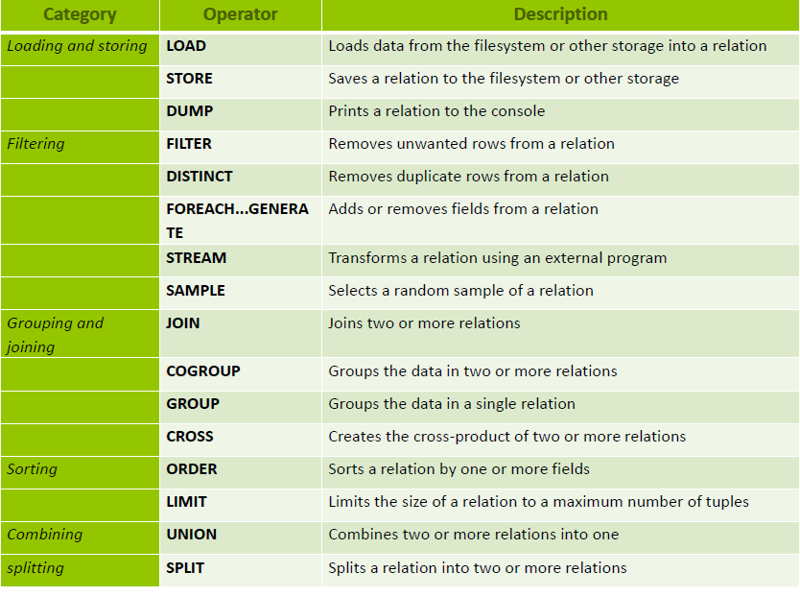
Introduction of Pig

Slide 15
Introduction of Pig
Load - Loads data from the file system.
Default : tab-delimited file using default load function PigStorage()
Eg: divs = LOAD '/data/examples/NYSE_divi dends';
divs = LOAD 'NYSE_dividends' USING HBaseStorage();
divs = LOAD 'NYSE_dividends' USING PigStorage(',');
Store - Stores or saves results to the file system.
STORE A INTO 'myoutput' USING PigStorage ('*');
STORE A INTO 'myoutput' USING HBaseStorage();
Dump - Displays the results in console.

Slide 16
Introduction of Pig
Foreach
foreach takes a set of expressions and applies them to every record.
A = LOAD 'data1' AS (a1:int,a2:int,a3:int);
DUMP A;
(1,2,2)
(4,2,1)
(4,3,3)
X = FOREACH A GENERATE a1, a2;
DUMP X;
(1,2)
(4,2)
(4,3)
Filter
The filter statement allows you to select
which records will be retained.
B = FILTER A by a1 >1 ;
(4,2,1)
(4,3,3)
Group
The group statement collects together records with the same key.
C = GROUP A BY f1;
DUMP C;
(1,{(1,2,3)})
(4,{(4,2,1),(4,3,3)})
Order by
Sorts a relation based on one or more fields.
D = ORDER A by a3 DESC;
(4,3,3)
(1,2,2)
(4,2,1)

Slide 17
Introduction of Pig
Distinct – Removes duplicate
(8,3,4)
(1,2,3)
(4,3,3)
(4,3,3)
(1,2,3)
X = DISTINCT A;
DUMP X;
(1,2,3)
(4,3,3)
(8,3,4)
Join
Performs an inner join of two or more relations based on common field values.
(1,2,3)
(4,2,1)
(7,2,5)
(2,4)
(1,3)
(4,9)
X = JOIN A BY a1, B BY b1;
(1,2,3,1,3)
(4,2,1,4,9)

Slide 18
Introduction of Pig
Limit:
divs = load 'NYSE_dividends';
first10 = limit divs 10;
Sample:
divs = load 'NYSE_dividends';
some = sample divs 0.1;
Parallel:
daily = load 'NYSE_daily' as (exchange, symbol, date, volume);
bysymbl = group daily by symbol parallel 10;

Slide 19
Introduction of Pig
Limit:
divs = load 'NYSE_dividends';
first10 = limit divs 10;
Sample:
divs = load 'NYSE_dividends';
some = sample divs 0.1;
Parallel:
daily = load 'NYSE_daily' as (exchange, symbol, date, volume);
bysymbl = group daily by symbol parallel 10;

Slide 20
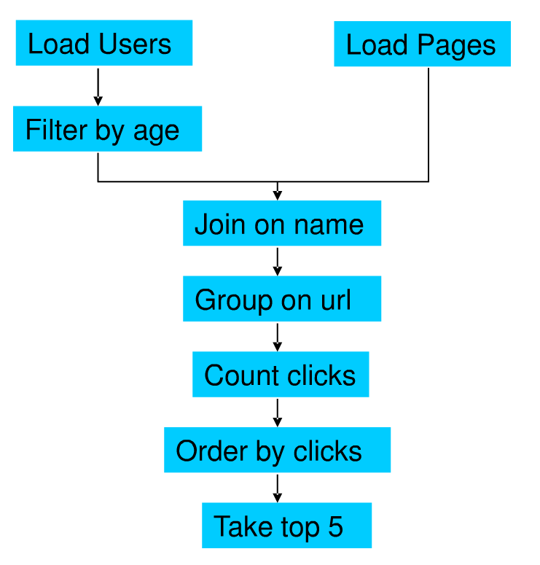
Pig script execution flow
Suppose we have user data in one file, website data in another file.
We need to find the top 5 most visited pages by users aged 18-25

Slide 21
Pig Script
users = load ‘users.txt’ as (name, age);
usersFltrd = filter users by age >=18 and age <=25;
pages = load ‘pages.txt’ as (user, url);
combinedData = join usersFltrd by name, pages by user;
grpData = group combinedData by url;
valCnt = foreach grpData generate group, count(combinedData) as hits;
sortData = order valCnt by hits desc;
top5 = limit sortData 5;
store top5 into ‘top5sites.txt;

Slide 22
Advance pig Latin
Flatten - un-nests tuples as well as bags.
Input : (a, (b, c))
GENERATE $0, flatten($1)
Output: (a, b, c).
Cross product when un-nesting bag of elements
Input: (a, {(b,c), (d,e)})
GENERATE $0, flatten($1)
Output: (a, b, c) and (a, d, e).
Nested foreach : - Apply a set of relational operators to each record in pipeline
daily = LOAD 'NYSE_daily' AS (exchange, symbol);
grpd = GROUP daily BY exchange;
uniqcnt = FOREACH grpd {
sym = daily.symbol;
uniq_sym = DISTINCT sym;
GENERATE GROUP, COUNT(uniq_sym);
};

Slide 23
Advance pig Latin
Joining small to Large data:
jnd = JOIN daily BY (exchange, symbol), divs BY (exchange, symbol)
USING 'replicated';
Second input should fit in memory
Inner and left outer only
The large relation is followed by one or more small relations
2 map-only joins.
Joining Skewed data:
jnd = JOIN cinfo BY city, users BY city USING 'skewed';
2 MR jobs;
with two-table inner join.
joining sorted data:
jnd = JOIN daily BY symbol, divs BY symbol USING 'merge';
sorted inputs

Slide 24
Advance pig Latin
Cogroup :
collects records of n inputs based on
a key. The result is a record with
a key and one bag for each input
Union:
(1,2,3) (2,4)
(4,2,1) (8,9)
(1,3)
X = UNION A, B;
(1,2,3)
(4,2,1)
(2,4)
(8,9)
(1,3)
Cross:
Cross product of two relation
(1,2,3)
(4,2,1)
(2,4)
(8,9)
(1,3)
X = CROSS A, B;
(1,2,3,2,4)
(1,2,3,8,9)
(1,2,3,1,3)
(4,2,1,2,4)
(4,2,1,8,9)
(4,2,1,1,3)

Slide 25
Advance pig Latin
Parameter substitution :
yesterday = FILTER daily BY date == '$DATE';
pig -p DATE=2009-12-17 daily.pig
Including Other Pig Latin Scripts :
import '../examples/ch6/dividend_analysis.pig';
daily = load 'NYSE_daily' as (exchange:chararray, symbol:chararray,
date:chararray, open:float, high:float, low:float, close:float,
volume:int, adj_close:float);
results = dividend_analysis(daily, '2009', 'symbol', 'open', 'close');

Slide 26
Advance pig Latin
Describe - shows schema of a relation.
A = LOAD 'student' AS (name:chararray, age:int, gpa:float);
DESCRIBE A;
A: {name: chararray,age: int,gpa: float}
A = LOAD 'data' AS (f1:int,f2:int,f3:int);
B = GROUP A BY f1;
DESCRIBE B;
B: {group: int,A: {f1: int,f2: int,f3: int}}
Explain - Displays execution plans
--explain.pig
divs = LOAD 'NYSE_dividends' AS (exchange, symbol, date, dividends);
grpd = GROUP divs BY symbol;
avgdiv = FOREACH grpd GENERATE group, AVG(divs.dividends);
STORE avgdiv INTO 'average_dividend';
bin/pig -x local -e 'explain -script explain.pig

Slide 27
User Define Function
Registering UDFs
REGISTER 'your_path_to_piggybank/piggybank.jar';
divs = LOAD 'NYSE_dividends' AS (exchange:chararray, symbol:chararray,
date:chararray, dividends:float);
backwards = FOREACH divs GENERATE org.apache.pig.piggybank.evaluation.string.Reverse(symbol);
Define UDFs:
define reverse org.apache.pig.piggybank.evaluation.string.Reverse();
backwards = FOREACH divs GENERATE reverse(symbol);
Calling Static Java Functions:
define hex InvokeForString('java.lang.Integer.toHexString', 'int');

Slide 28
Big Data
You have successfully completed –
Pig Basics Course

